Slide 1


Multi Class Animal Recognition For Wildlife Conservation Richard Gomes AICTE ID : STU66dcb2f1666421725739761

Slide 2

Learning Objectives
Use of CNN Model with respect to Animal Recognition.
Learn to use MobileNETV2.
Explore and build the model for 90 Animal classes.
Learn how to preprocess image data and build a visual pipeline using Python.
Accuracy was analyzed.
Understand real world application by concerning and monitoring the wildlife.
GOAL
Source :
www.freepik.com/

Slide 3
Tools and Technology used
Programming Language: Python
Libraries: TensorFlow / Keras – for building and training models Matplotlib – for visualization
Development Environment: Google Colab
Pre-Trained Model: MobileNETV2
Dataset: https://www.kaggle.com/datasets/iamsouravbanerjee/animal-image-dataset-90-different-animals/data

Slide 4
Methodology
1. Data Collection
2. Processed the Data
3. Model Selection
4. Trained the Model
5. Evaluation of the Model
6. Testing

Slide 5
Problem Statement:
Identifying and classifying animal images for wildlife monitoring and surveillance, especially useful in cases related to animal extinction. The dataset is categorized into 90 distinct animal classes.

Slide 6
Solution:
We utilized the pre-trained MobileNetV2 model to classify images into 90 animal classes using the Softmax activation function. The model performed well even without regularization and is optimized for use on mobile and resource-constrained devices.

Slide 7
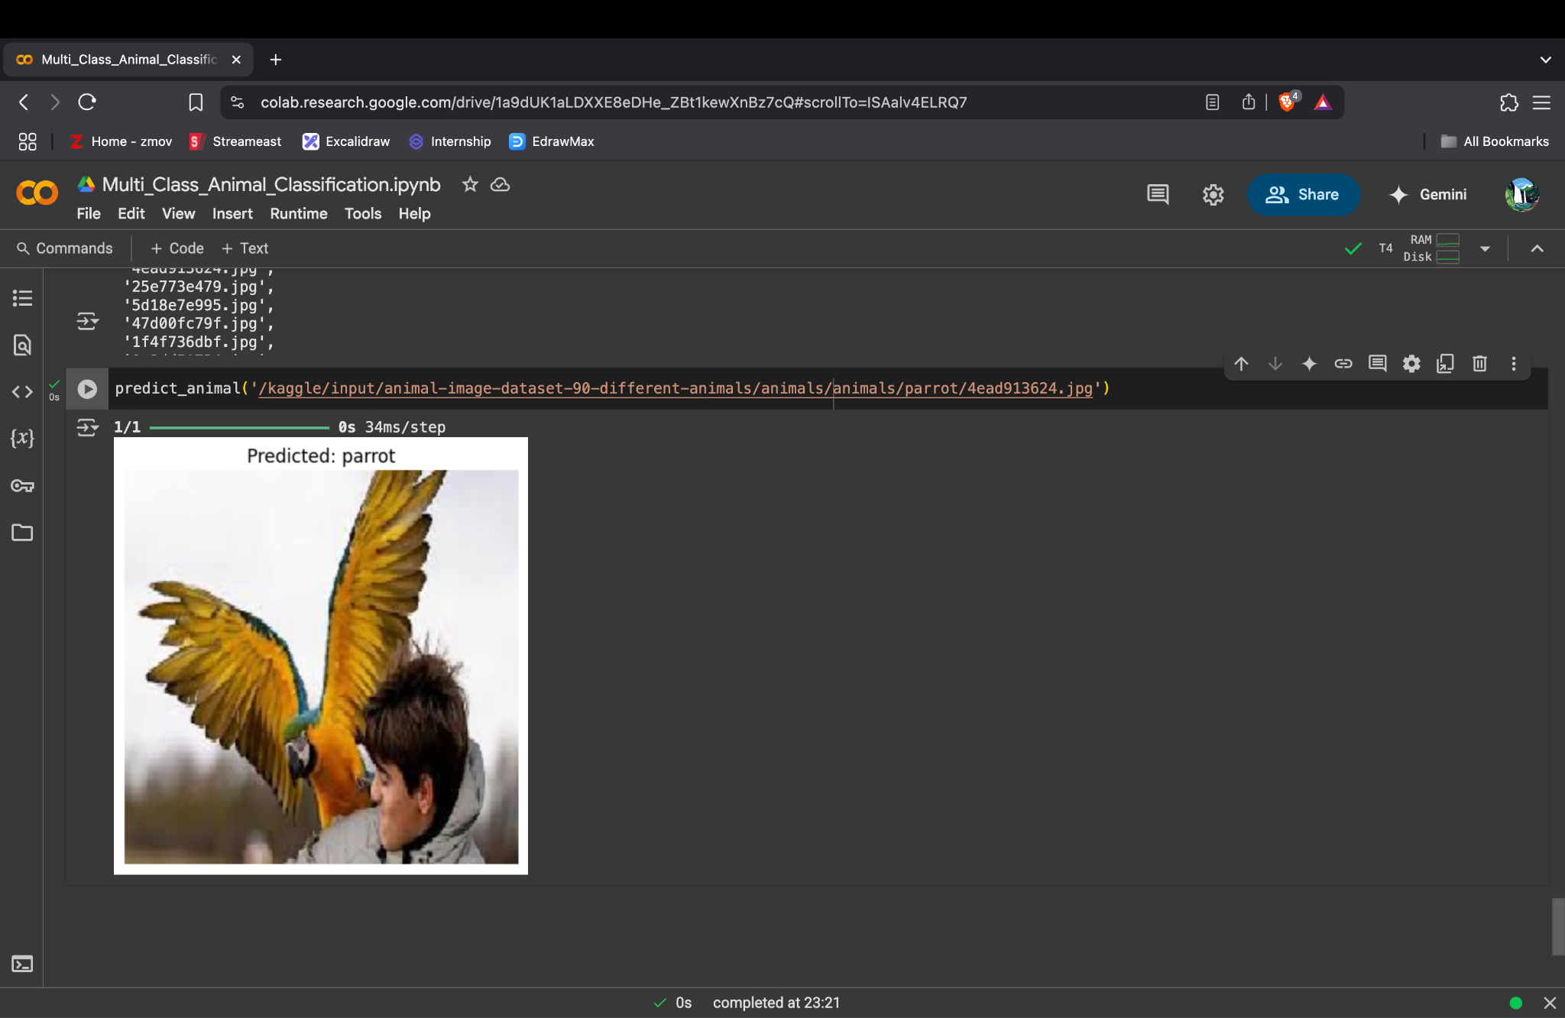
Screenshot of Output:

Slide 8
Conclusion:
- Achieved an accuracy of 84.63% on the validation set.
- Effectively handles a large number of classes (90).
- Scalable for real-world deployment in wildlife monitoring and surveillance.
- The model is suitable for object recognition tasks beyond animal classification.
- GitHub Repository: https://github.com/rich1ebytes/MultiClassAnimalClassification.git

